Slide 1
Layer 1
Layer 2
Layer 3
INPUT OBSERVATION
Output Response
Flow of Computation

Slide 2
Input
Layer 1
Layer 2
INPUT OBSERVATION
N1
Output Response
N3
N2
Flow of Computation

Slide 3
Initial value
Value after 1 training cycle
Value after 2 training cycles
Value after 3 training cycles
Model stabilizes

Slide 4
Initial value
Value after 1 training cycle
Value after 2 training cycles
Value after 3 training cycles
Model stabilizes

Slide 5
Predefined
Epoch
Limit
Optimal CV Error
Optimal Training Error

Slide 6

Data Batching
Training the Network (per epoch)
Get training data
Split into training batches
Feed a batch into the network
Repeat process until all batches are processed
Network Design
Determine neuron
architecture
Determine network
architecture
Update weights with
gradient descent
Calculate the error term
$$Σ\frac{{\left(y_{true}−y_{pred}\right)}^{2}}{n}$$

Slide 7
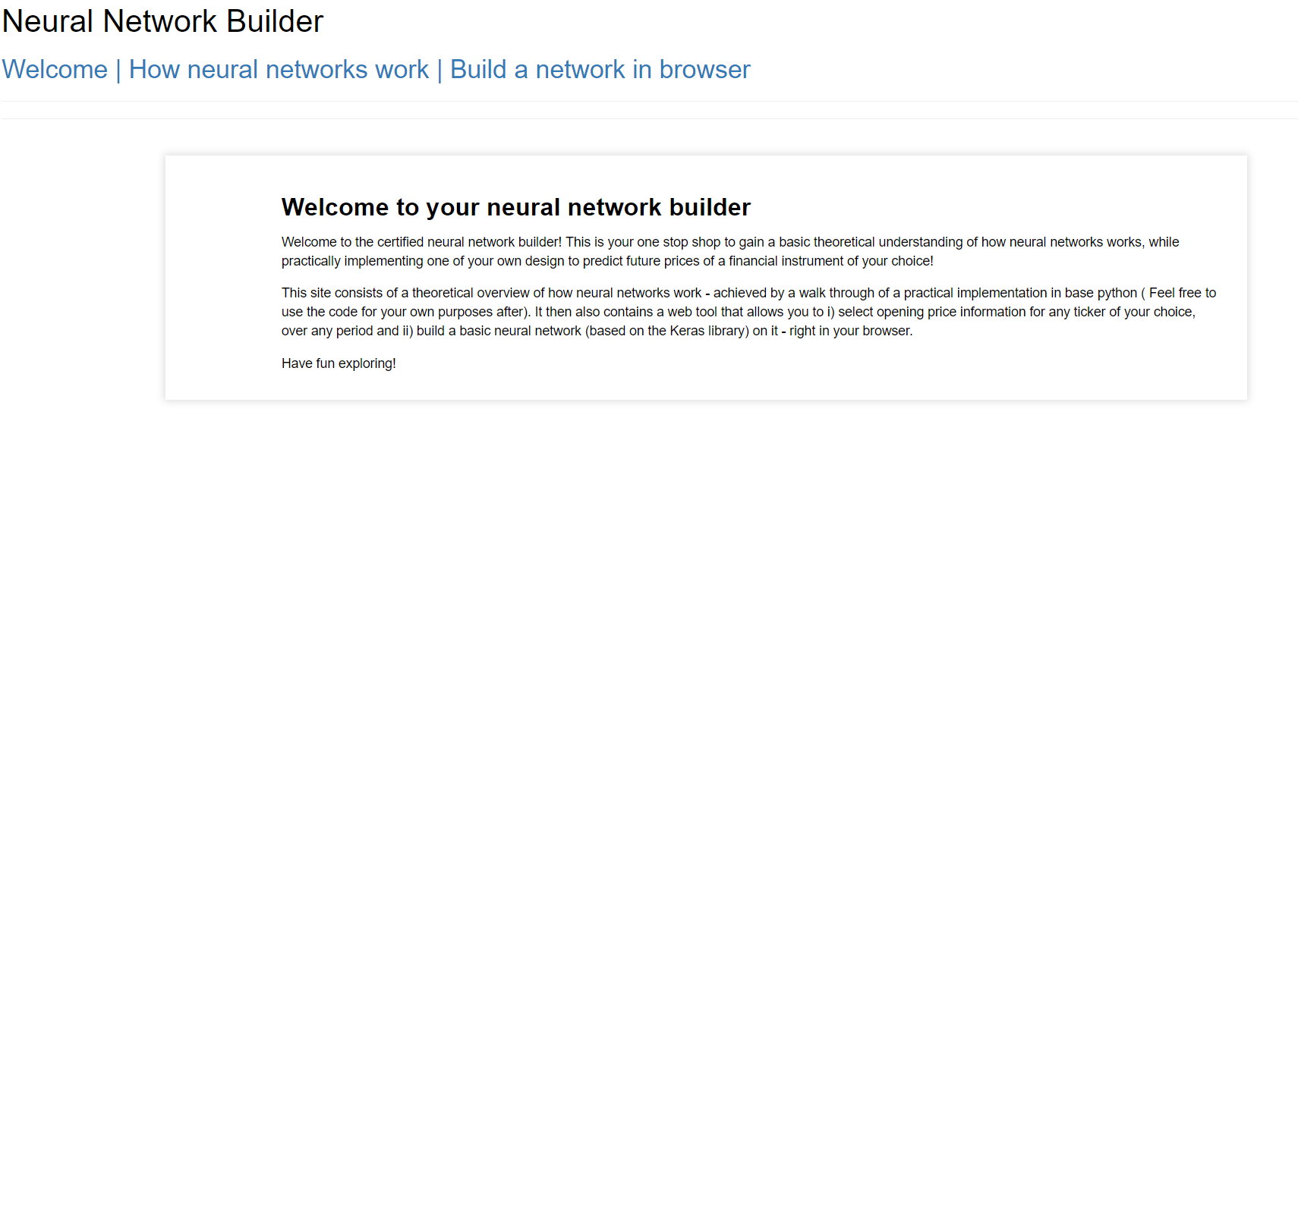
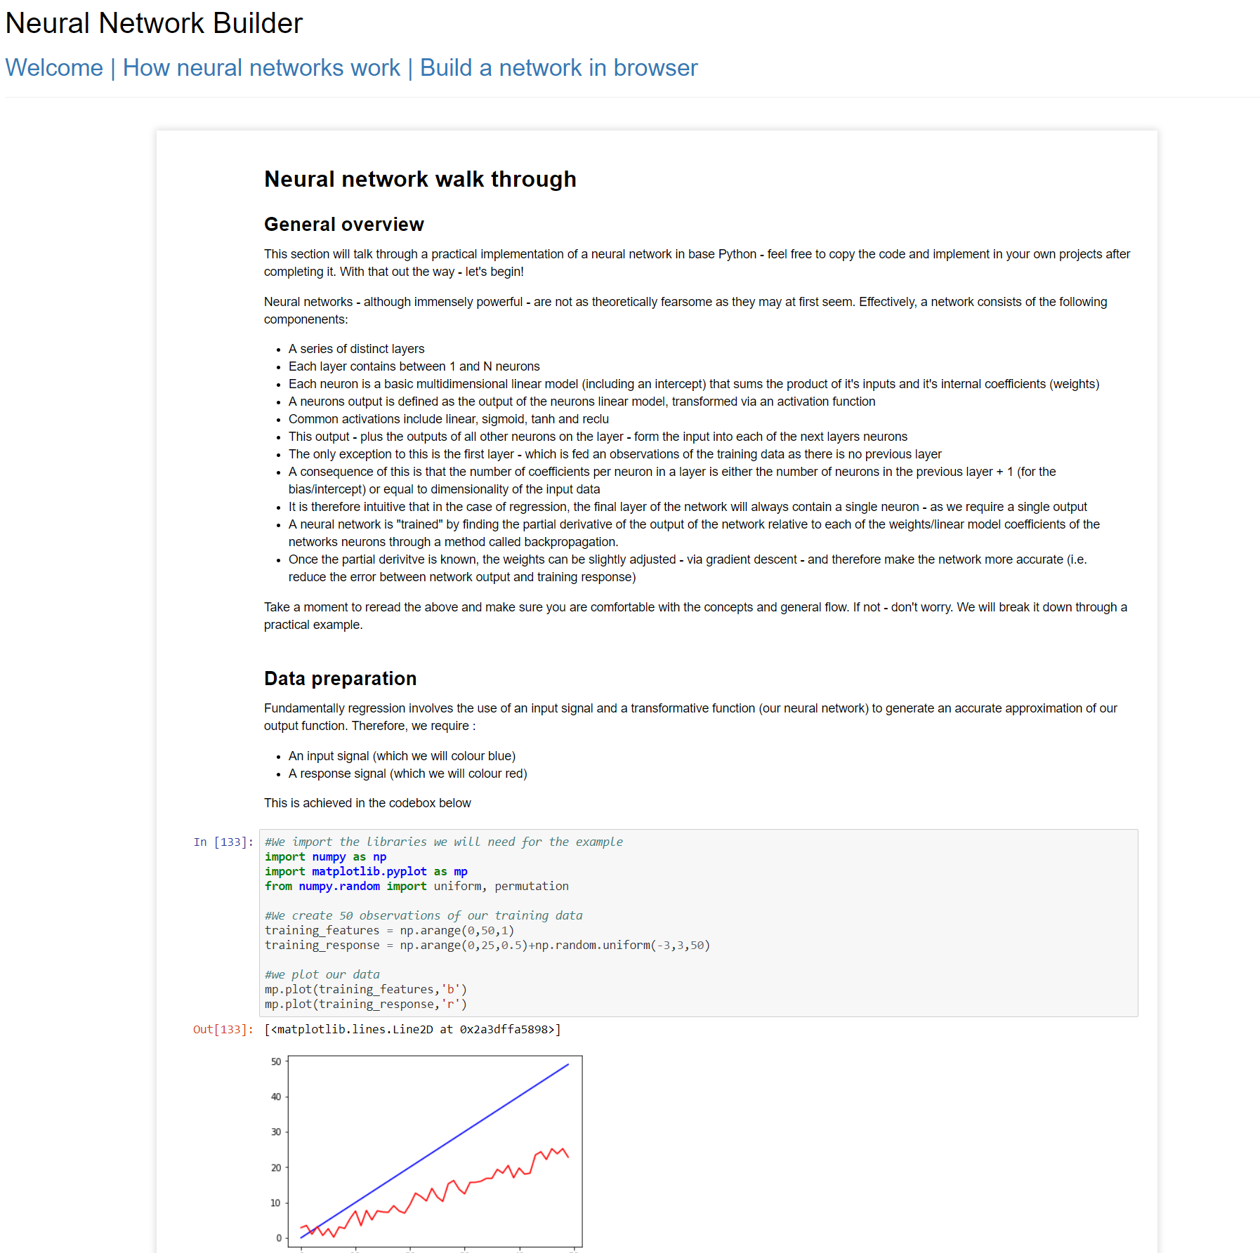
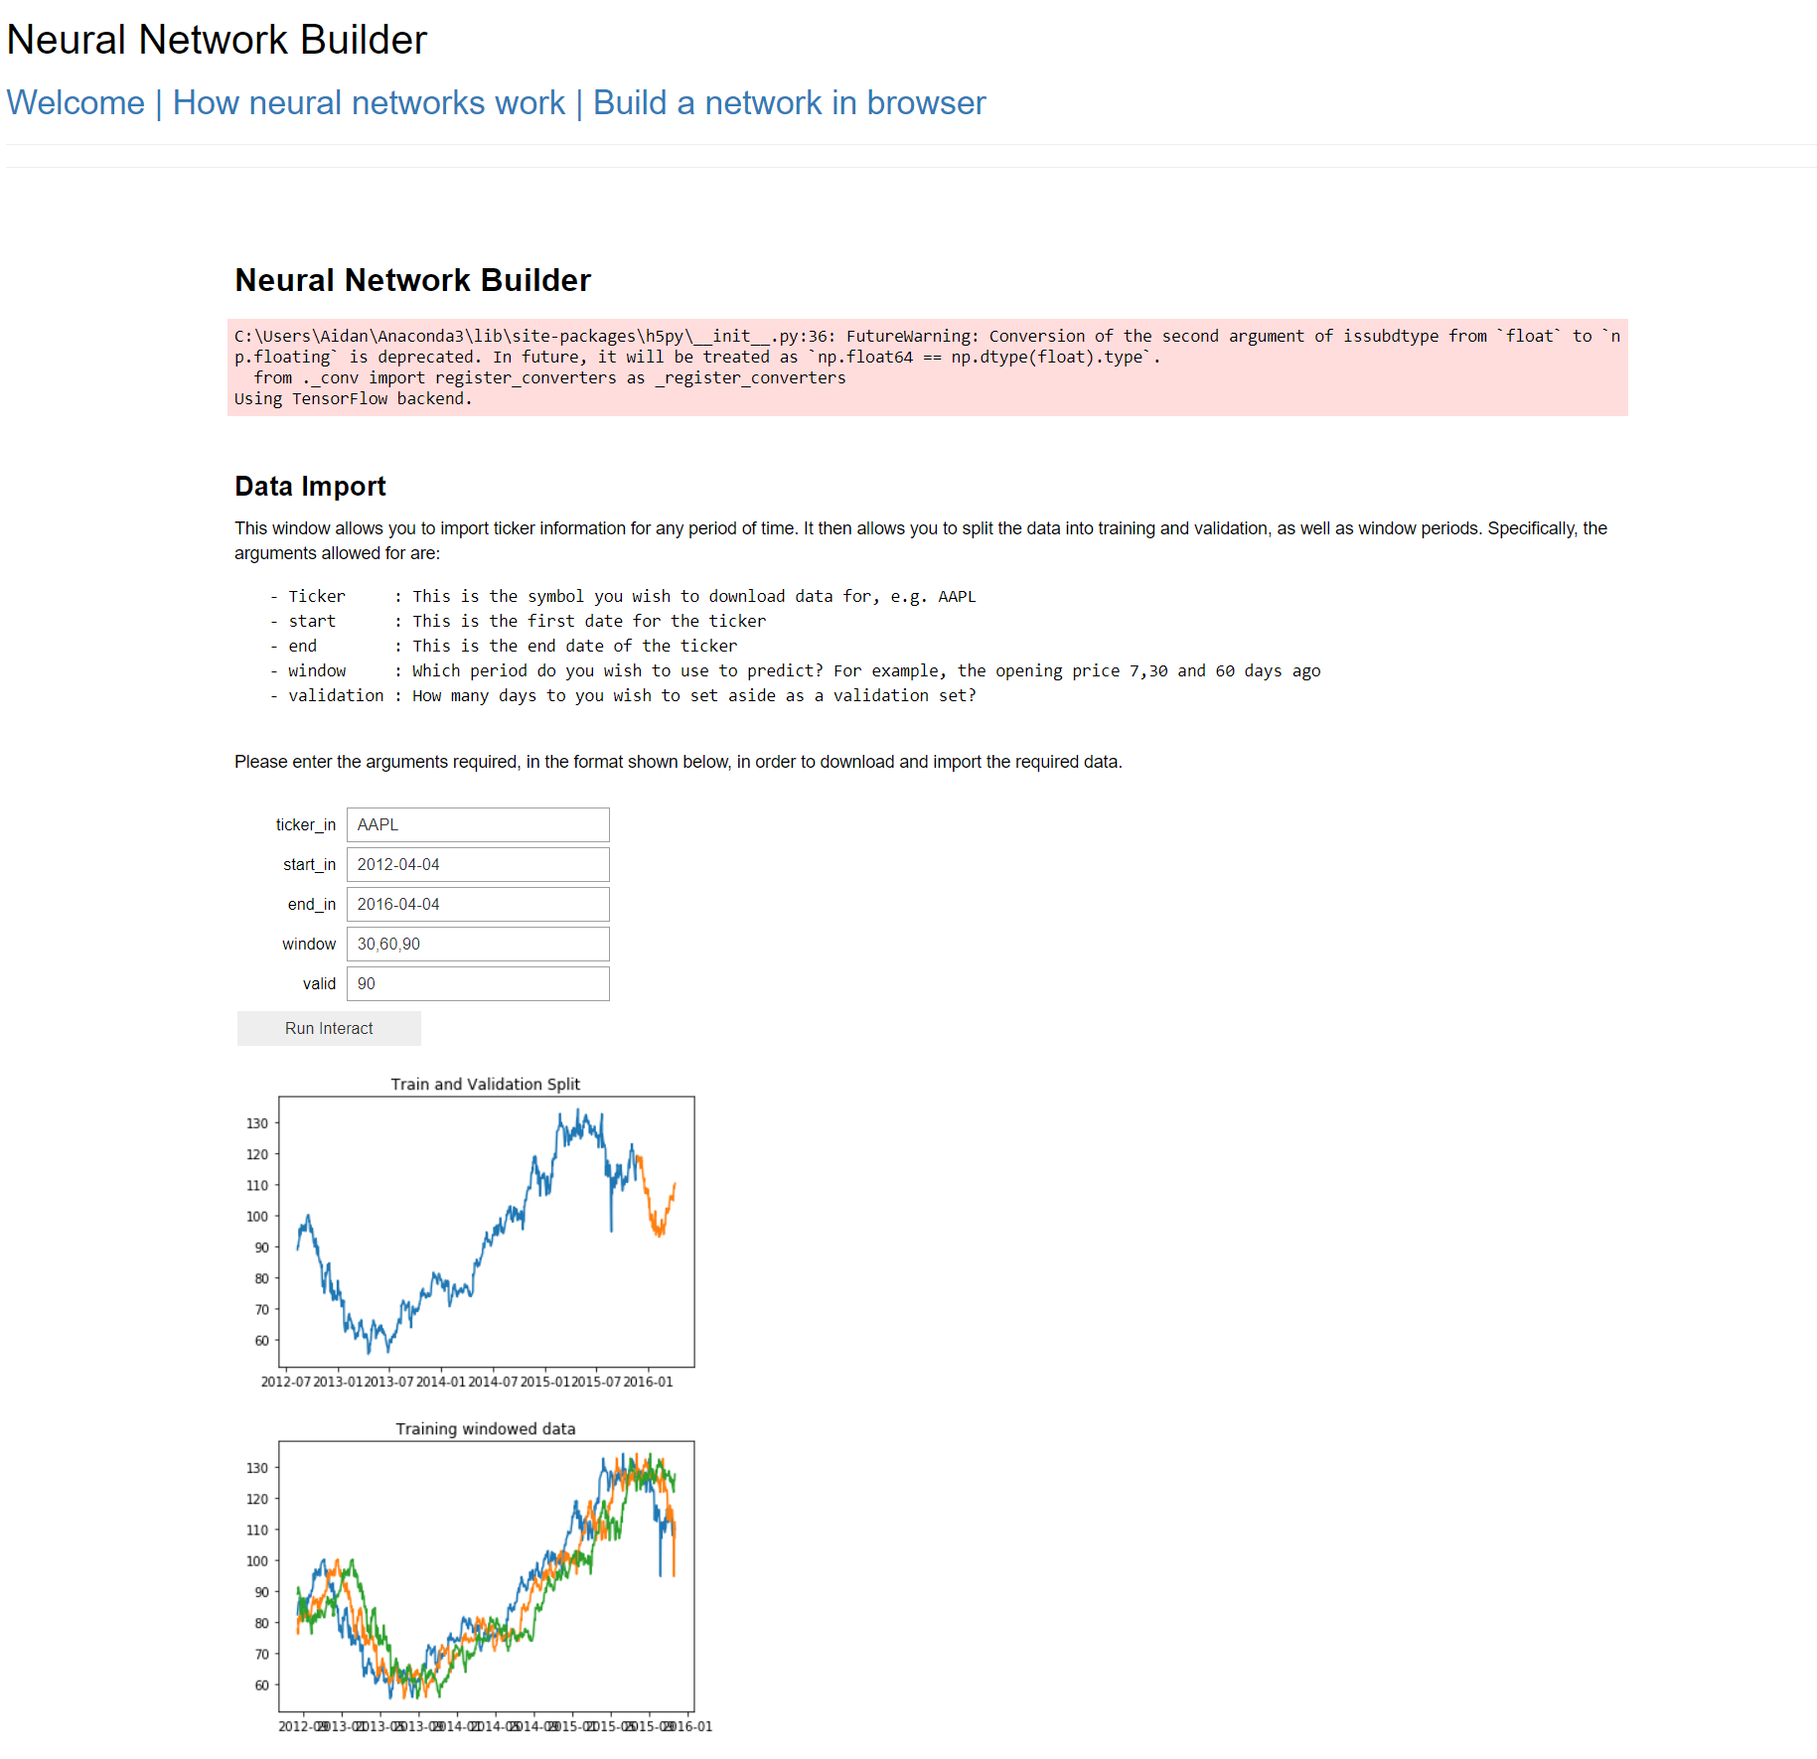
Splash Page
Tutorial
Neural Network

